Slide 1
Dreaming Europe
Gillian Dow
Catriona Seth
Nicola Watson

Slide 2
Dreaming Europe: or, RÊVE (Romantic Europe: The Virtual Exhibition)

Slide 3
ERA (European Romanticisms in Association)
Founded Nov 2016 in Rome
Brings together scholars, scholarly associations & museums
To retrieve, revalue, re-present transnational aspects of European Romanticisms
To develop new pan-European connections between academia and heritage organizations
To produce exchange of knowledge, practical innovation, creative experimentation

Slide 4
Participants
Anglo-Hispanic Horizons
British Association for Romantic Studies
CETAPS
Chawton House Library
CISR (Bologna)
German Sociey for 18th C Studies
French Society for 18th C Studies
The Keats-Shelley House, Rome
International Council for Literary Museums

Slide 5
Participants (cont)
Petöfi Museum, Budapest
Lithouses Association
The Wordsworth Centre
Musée de la Vie Romantique, Paris
Museo Byron, Ravenna
Museum of Romanticism, Frankfurt
Nordic Association for Romantic Studies
French Society for the Study of Romanticism

Slide 6
Projects
A series of interdisciplinary events distinguished by collaboration between academia and libraries, museums, galleries, theatres etc with an interest in Romantic culture
Exploring the north, south, east and west of European Romanticisms
Projected events Bologna, Budapest, Paris, Ravenna, Cadiz, Porto, Frankfurt, the Lake Dustrict UK
Projected themes include anniversaries, house-museums, European Gothic, transnational poetic form, revolution, translation

Slide 7
Project RÊVE
Romantic Europe: The Virtual Exhibition
Identifies and considers iconic objects that epitomise/construct European aspects of Romanticism
Brings them together in an innovative, online, plurilingual museum to tell a new story about European Romanticisms
A medium of cultural, creative and intellectual exchange, allowing for new ways of thinking ‘bottom-up’ about the materiality of Romanticism as it moved across borders

Slide 8
Aims I
A laboratory for experimenting with virtual exhibition
A new pedagogical resource
A way of engaging the wider public with research

Slide 9
Aims II
To display c. 100 objects
Bring untouchable, fragile objects out of store and up close
Display the otherwise immovable
Bring dispersed things into intriguing conjunction
Show items from private collections
Interpret lost iconic objects
Narrate items in new technological formats
Dramatise exhibits by releasing them in association with anniversaries
Experiment with new creative responses to such objects

Slide 10
Format
RÊVE will take the form initially of a blog-post released monthly.
http://www.euromanticism.org/
Three posts launching today… which exemplify some of our ambitions: to display the fragile and the rarely-shown, and the otherwise immovable, to highlight the trans-European aspects of Romantic materialities

Slide 11
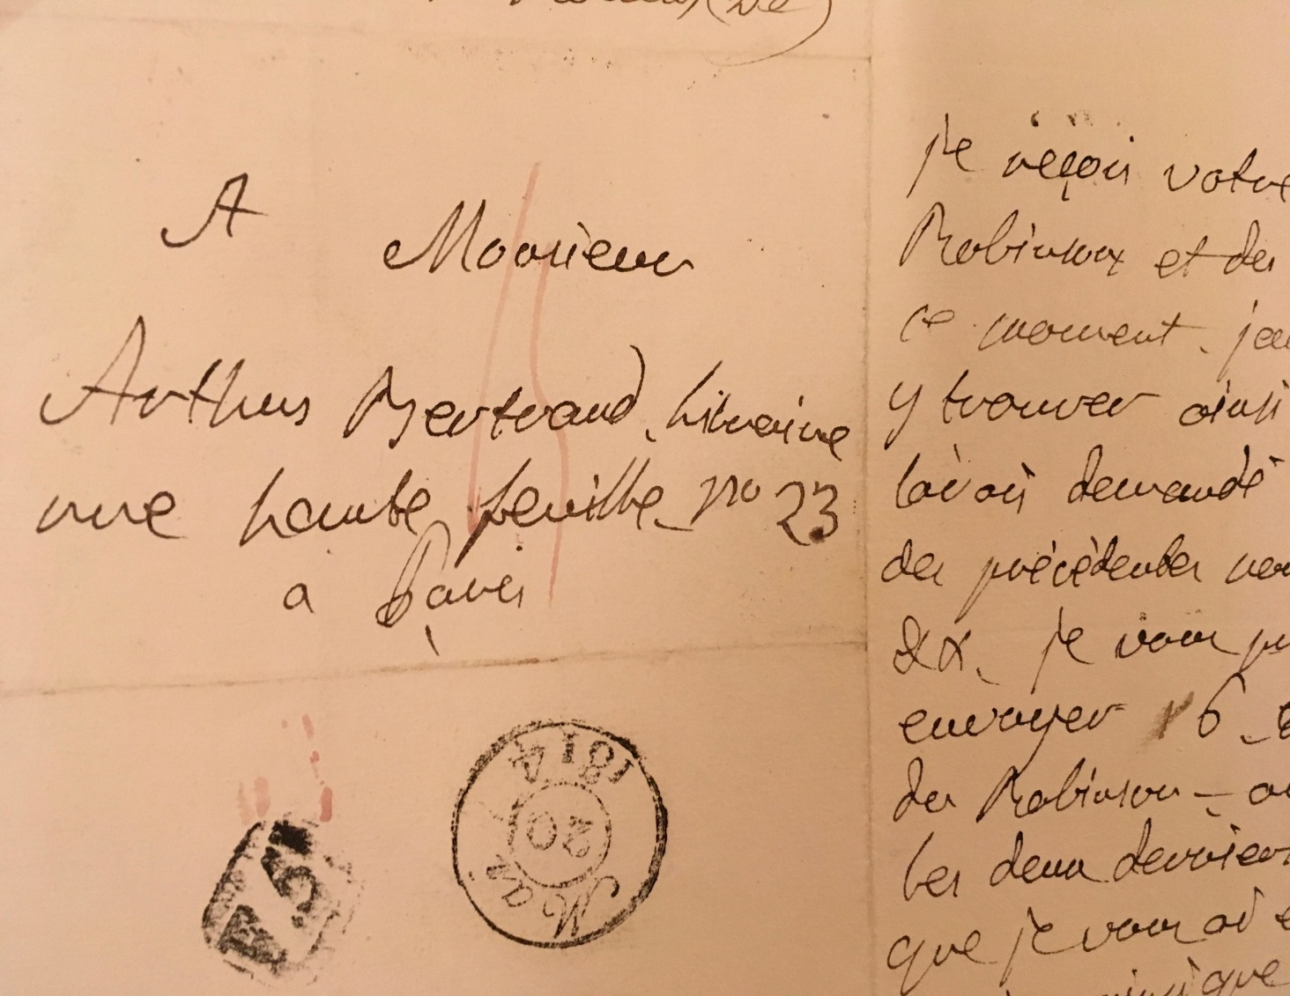
Post 1 The European Jane Austen

Slide 12
Post 2 A real picture from the fictional Corinne’s gallery

Slide 13
Post 3 Rousseau’s Trapdoor

Slide 14
Coming Soon…
Teresa Guiccioli’s lock of Byron’s hair
The mortar at Cadiz
Bettina von Arnim’s travelling-bag
Thomas Moore’s harp
http://www.euromanticism.org/

